Slide 1
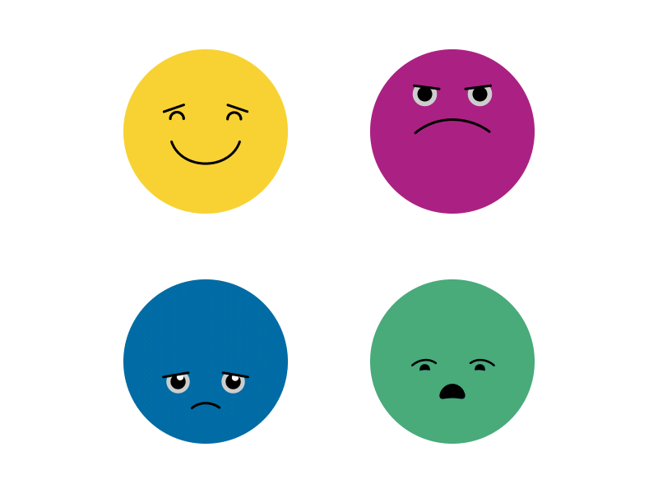
Managing Emotions
Image from: 4 emotions by Bobby Voeten on Dribbble

Slide 2
Introductions
Claire Tooth - Education Mental Health Practitioner (EMHP)
What is the EMHP role?
Deliver 1:1 interventions for children and young people with mild-moderate MH problems.
Supporting schools to grow and develop their “Whole School Approach” to mental health and wellbeing.
Advice and signposting to/liaising with other services.

Slide 3
Aims
To know the difference between feelings and emotions.
To understand that children may communicate their emotions and difficulties through their behaviour.
To understand anger and how to support this.
To know some practical strategies that can be used to support children to manage their emotions.

Slide 4
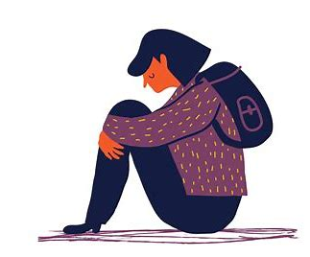
Feelings & Emotions
Emotions – how we feel about something and how our body reacts.
Feelings – how we experience our emotions and give meaning to them. They are different for everyone.
(Mind.org.uk)

Slide 5
Types of feelings
Different types of feelings might include:
Not feeling yourself
Feeling something isn’t right
Finding it hard to enjoy things
Feeling angry, worried or sad
(www.mind.org.uk)
Feeling energetic or hyperactive
Struggling to concentrate or focus
Feeling out of control
Feeling like you want to be alone

Slide 6
What do you think can cause difficult feelings?

Slide 7
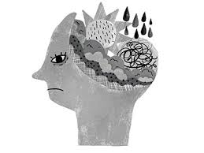
What can cause difficult feelings?
There are lots of things that can affect the way a young person feels:
Problems at home, school or with friends
Losing someone important
Confusion about who they are (identity, sexuality)
Changes or big events
Pressure from self or others
Feeling lonely
(www.mind.org.uk)

Slide 8
What can cause difficult feelings cont.
There are lots of things that can affect the way a young person feels:
Being bullied
Feeling unwell
Being abused
Worry about things that are happening, the world around them
Worry about things they see on social media
Traumatic or frightening experiences
(www.mind.org.uk)

Slide 9
Behaviour and emotions
The way a child behaves is often a communication about how they are feeling.
There may be a range of emotions going on for the child which they are unlikely to be aware of or able to talk about.
Underneath the challenging behaviour, a child may be feeling:
Worried
Anxious
Insecure
Sad
Uncertain
Frustrated
Angry
Jealous
Bored
Overwhelmed
Out of control
Unsafe
Ignored
Unheard
Invisible
Unloved
Guilty
Ashamed
(YoungMinds)

Slide 10
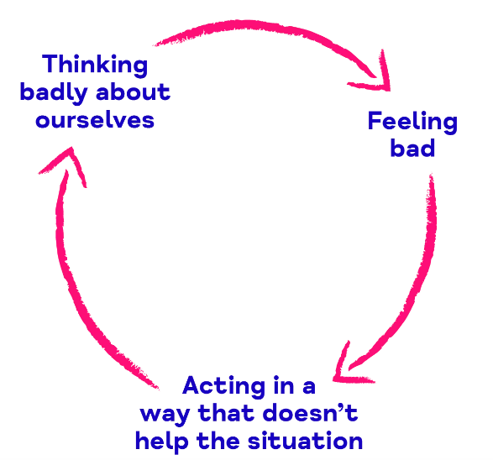
Emotions and mental health
Our feelings can have a huge impact on our mental health! Our thoughts (what we think about ourselves and situations), feelings (part of our emotions and how we experience them) and behaviours (the way we act and respond) are all linked.
When a situation arises, our thoughts, feelings and behaviours connect to give us our experience – we need to be aware of this so that we can judge how mentally well, or not, we are feeling.
(www.mind.org.uk)

Slide 11
Emotional regulation
Emotional regulation means being able to manage your emotions, so that they don’t overwhelm you.
A young person who struggles with emotional regulation may appear to have an impulsive, exaggerated response to a situation. Alternatively, it may be a build up to a behavioural outburst.
Emotional regulation is something that is learnt and young people need support to develop this.

Slide 12
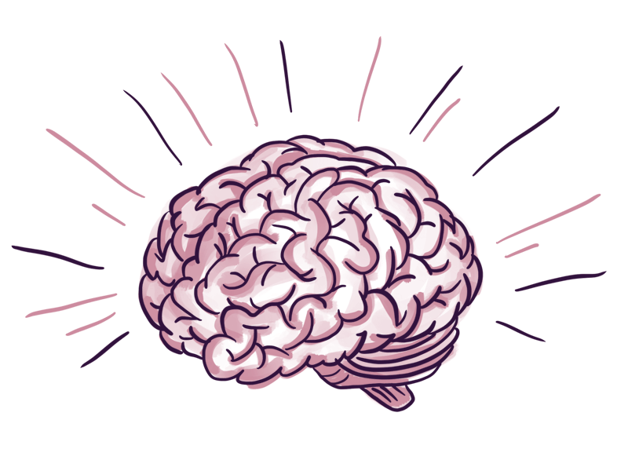
The science behind our emotions!
When we are angry/upset/stressed, we produce the stress hormone cortisol.
We then go into the fight/flight/freeze response – this is our body’s response to danger.
It can cause symptoms like: increased heart rate; butterflies in the stomach; nausea; shaking; sweating; dry mouth; change in breathing rate.

Slide 13
The science behind our emotions!
Notes:
Why Do We Lose Control of Our Emotions? - YouTube

Slide 14
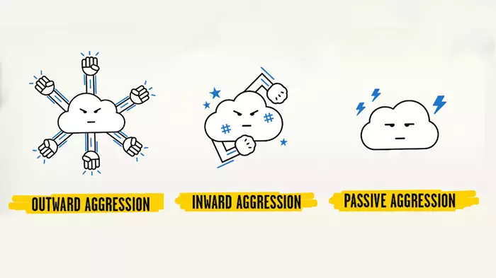
Anger
We all experience anger and it’s normal to feel angry about things you may have experienced. Anger can start to be unhelpful when it is expressed through destructive or unhelpful behaviour.
Aggression can be:
Outward
Inward
Passive
(YoungMinds, 2021)

Slide 15
Anger
Children can feel angry for lots of different reasons, or maybe they don’t even know why they feel angry!
It can be hard to think things through when angry and if we are constantly thinking angry thoughts about ourselves and others then it’s hard to step back and communicate in a healthy and productive way.
Early warning sings of anger include: tensing up; clenching teeth; increased heart rate; churning stomach; clenching fists.
After getting angry, children may then feel guilty about it, which can then lead them to feeling even worse.
(YoungMinds, 2021)

Slide 16
Tips for managing anger
Exercise
Write down what you want to say
Talk about it
Keep an anger diary
Anger dos and don’ts
Relaxation
Burst bubble wrap
Count to 10
Breathe slowly and deeply
Use a stress ball
Leave a situation
Hit something soft
Do something else
(Childline & YoungMinds, 2022)

Slide 17
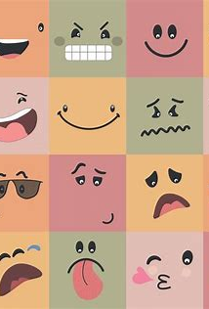
Tips for supporting emotional regulation
To remove cortisol from the system, we need oxytocin (love hormone).
We can help children produce oxytocin by:
Reassurance
Empathy
Guidance
Acknowledgement

Slide 18
Tips for supporting emotional regulation
Practice positive feelings
Encourage positive self-esteem
Put emotions into words
Coaching
Practice runs
Consider the meaning to the young person
Self-reflection

Slide 19
Resources for supporting emotion management…

Slide 20
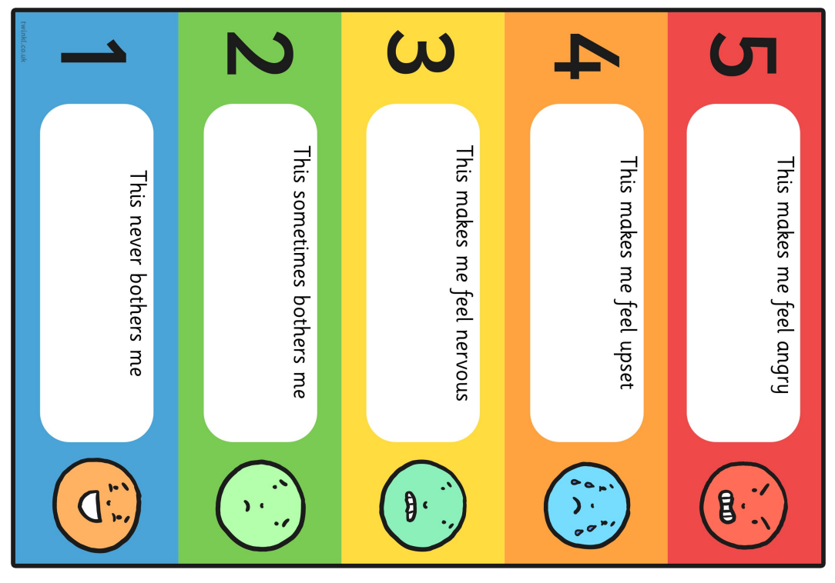
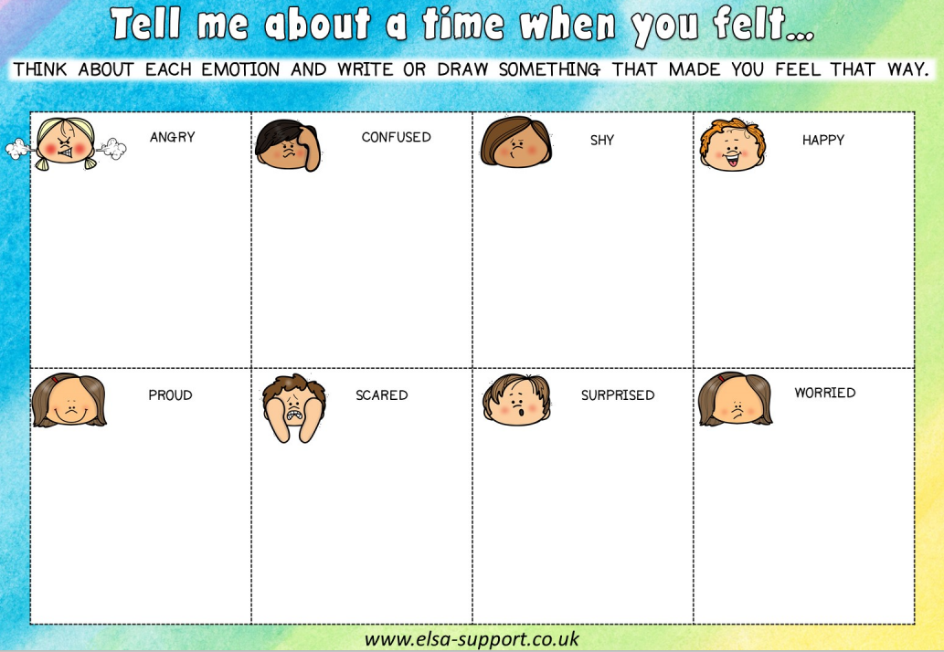
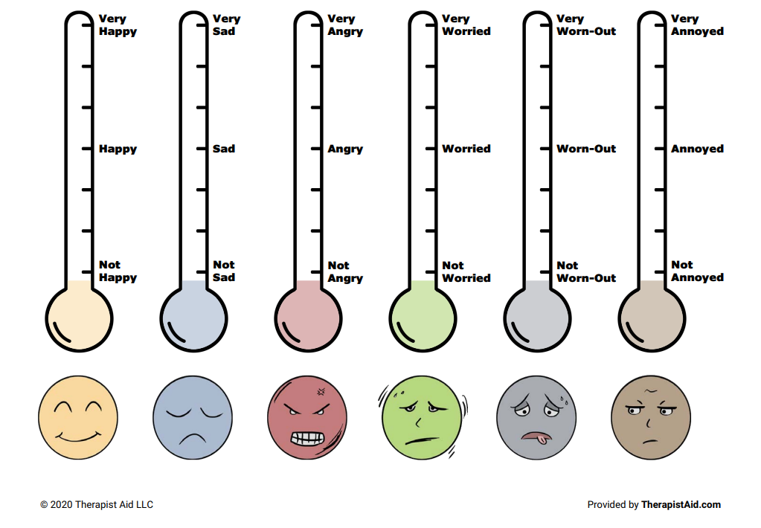
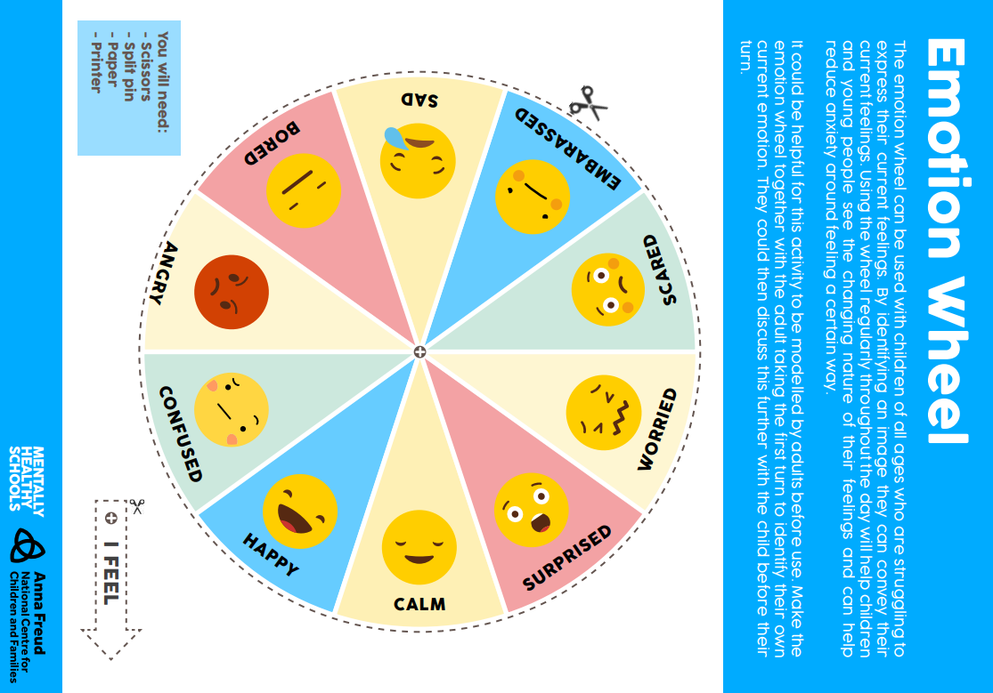
Recognise emotions
Children need to be able to name and understand the different emotions – this will help them to recognize these emotions in themselves.
Visual aids, thermometers, games and trigger scales are useful tools to help children recognize their emotions.
Taken from: emotion-thermometers.pdf (therapistaid.com); Feelings Trigger Chart (twinkl.co.uk); emotion-wheel.pdf (mentallyhealthyschools.org.uk); Resources for Emotional Literacy Support Assistants - ELSA Support (elsa-support.co.uk)

Slide 21
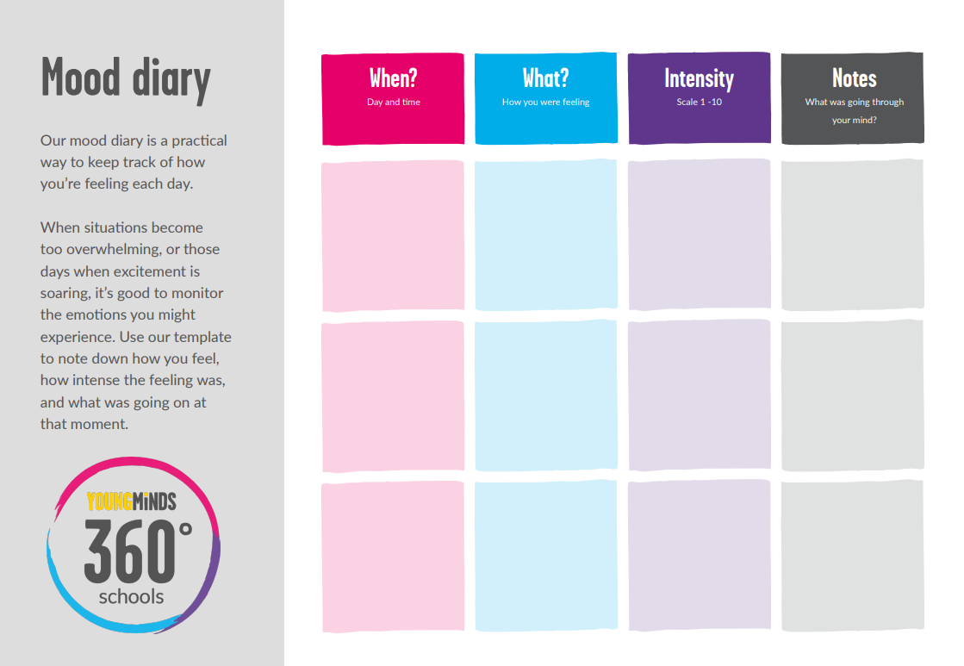
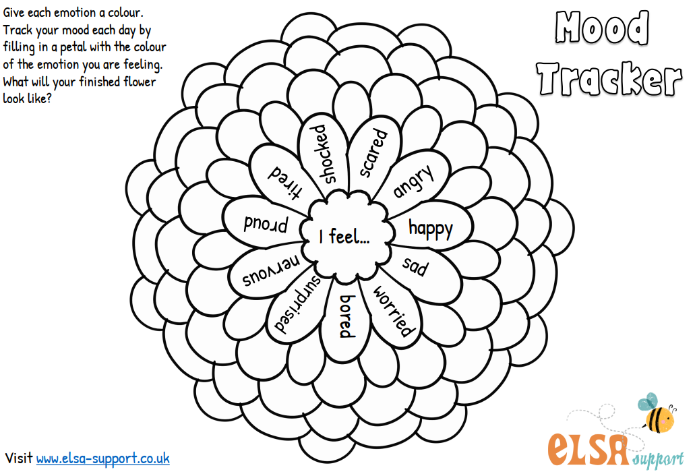
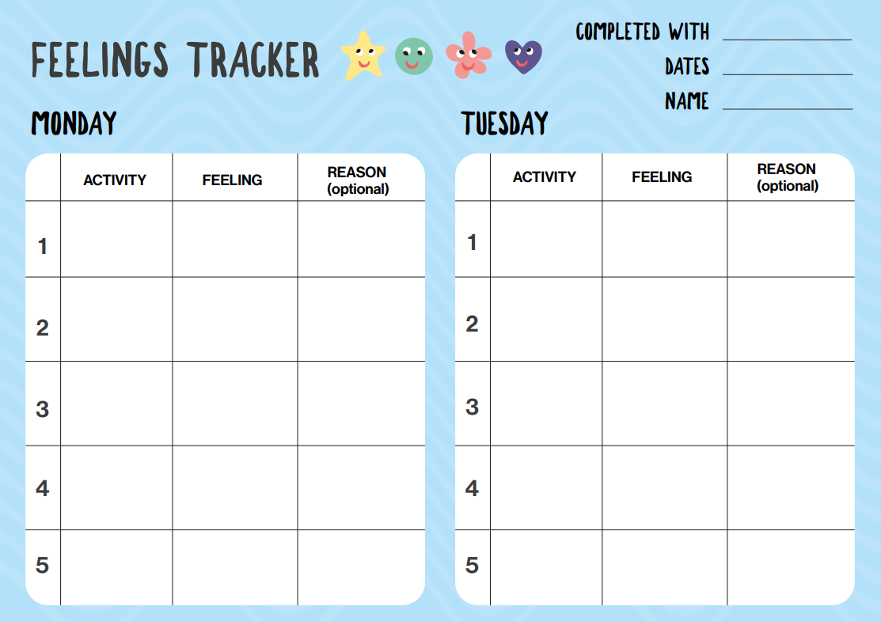
Emotion Trackers
Encourage your child to keep a mood diary – this can help them to track their mood on different days.
Discuss what may have caused the low mood on certain days? What caused the better mood? Try to look for patterns and then plan how to help their mood.
Taken from: Resources for Emotional Literacy Support Assistants - ELSA Support (elsa-support.co.uk); Tracking My Feelings (mentallyhealthyschools.org.uk); mood-diary.pdf (youngminds.org.uk)

Slide 22
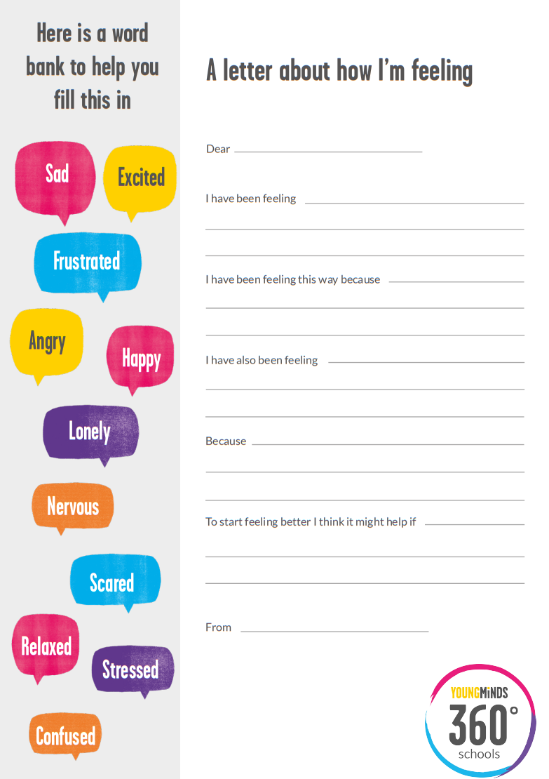
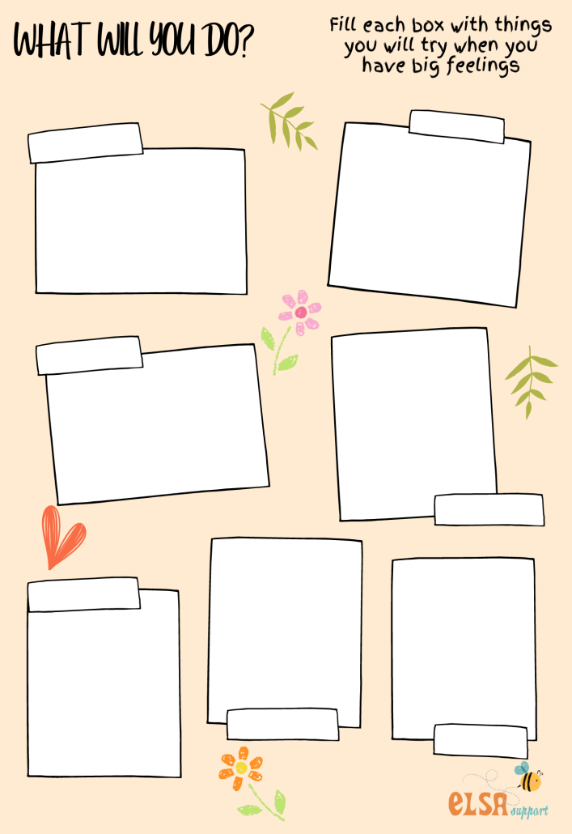
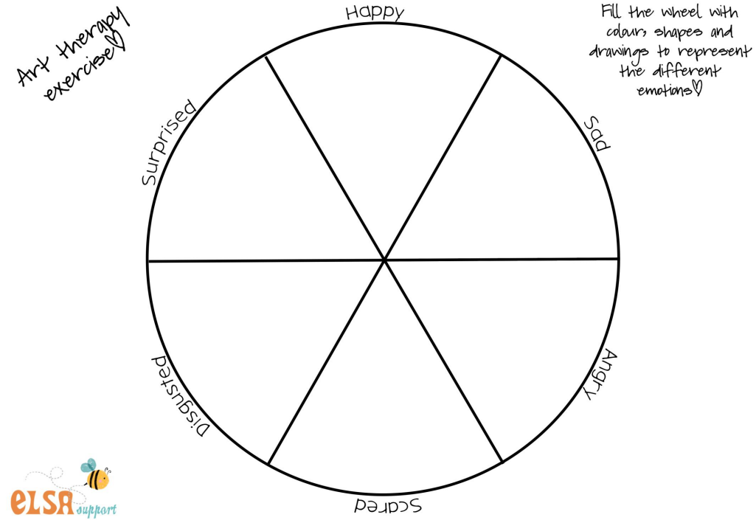
Get creative!
Some children find it difficult to talk about their feelings – so encouraging them to express their feelings creatively can be really useful.
Ask them to draw how they are feeling instead or to write it down in a letter.
Taken from: Resources for Emotional Literacy Support Assistants - ELSA Support (elsa-support.co.uk); a-letter-about-how-i-m-feeling.pdf (youngminds.org.uk)

Slide 23
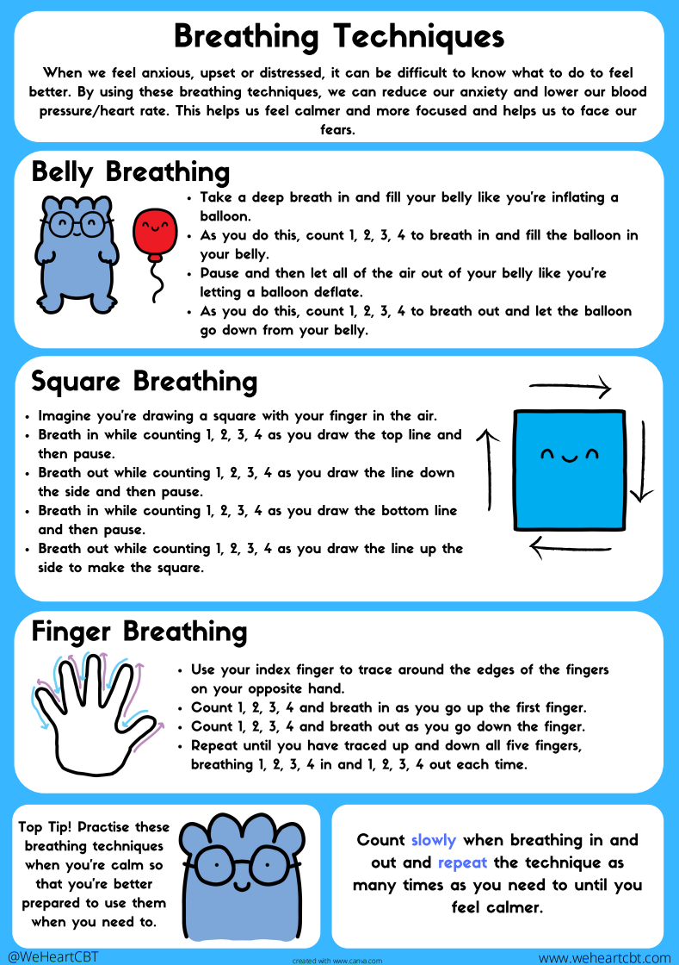
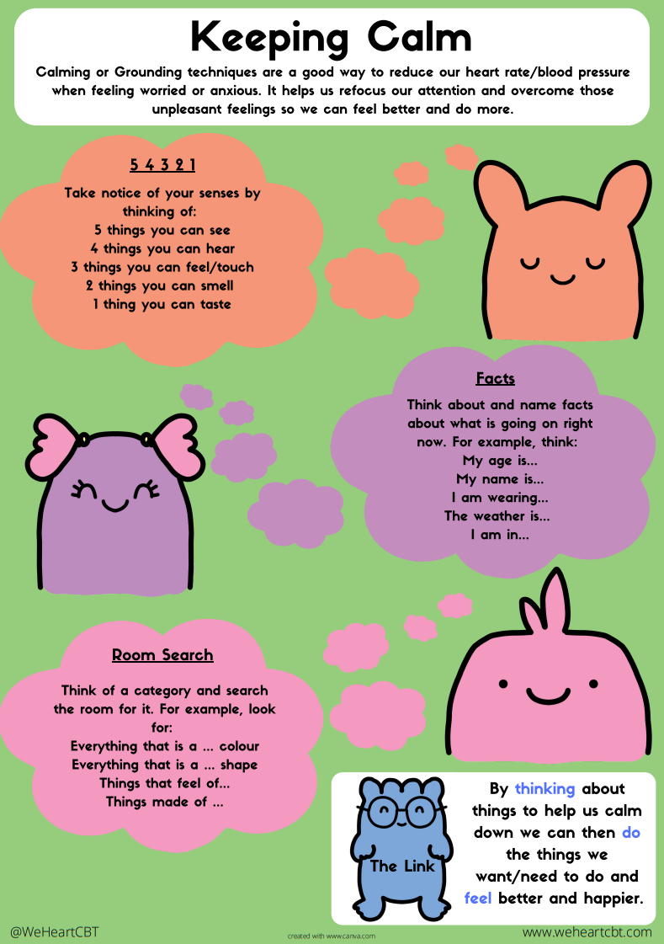
Relaxation
When feeling dysregulated, using different relaxation techniques can help to calm children back down again.
Relaxation activities can include mindfulness, breathing exercises, grounding techniques, or just anything that takes their mind off things!
Taken from: WeHeartCBT

Slide 24
What to do if more support is needed?
Look at the Open Minds website – this has lots of great resources and tips for young people.
The Open Minds Partnership includes different services in Calderdale which offer different kinds of support:
Time Out – guidance about emotional wellbeing, managing worries and looking after yourself. 10-19 years.
Kooth – online, anonymous counselling. 10-25 years.
Barnardo’s Positive Identities – advice and support for those who identify or are questioning their gender and/or sexual identity. 8-25 years.
Calderdale Young Carer’s Service – advice and guidance on being a young carer. 8-18 years.
Branching Out – specialist support and advice around drugs and alcohol. 10-21 years.
The Brew Project – 1:1 support sessions or 1:1 ‘walk and talk’ service. 5-17 years.
Calderdale School Nursing Team – help to manage long and short-term conditions in education settings for children and young people. 5-19 years.
Open Minds (CAMHS) – advice and signposting, 1:1 specialist mental health support. 5.18 years.

Slide 25
SilverCloud: Digital Mental Health Support
Currently, SilverCloud offers children and young people five programmes of mental health support. Three for young people and two for parents/carers of children and young people.
Free, minimal wait times, early intervention for mild/moderate anxiety/low mood
Space From Anxiety –This programme is an online intervention aimed at alleviating psychological distress arising from anxiety related symptoms. This programme has been developed to help young people aged 14 years and over manage these feelings and the causes of them, ultimately offering welcome space from anxiety.
(NEW) Space From Low Mood – Another online programme that has been designed to relieve the symptoms of low mood in young people by focusing on developing more flexible ways of thinking, increasing awareness and understanding of emotions and understanding their mood, as well as their triggers. This is aimed at supporting young people 14 and above.
(New) Space from Low mood & Anxiety - The Space from Low Mood & Anxiety programme has been designed to relieve the symptoms of low mood and anxiety in young people by focusing on developing more flexible ways of thinking, increasing awareness and understanding of emotions and understanding their mood, as well as their triggers, and warning signs of low mood and anxiety. This is aimed at young people 14 and over
Supporting an Anxious Child (4-12 years) and Supporting an Anxious Teen (13 plus) are online interventions for parental use alongside their child. The programmes are based on CBT and built in conjunction with leading clinical experts. These programmes provide psychoeducation, tools and activities in a safe confidential space to help parents support their children or teens.
For more information please contact silvercloud@northpoint.org.uk or 01422 300 001. Referrals can be made here:
Silvercloud | Northpoint Wellbeing - Open Minds (CAMHS) (openmindscamhs.org.uk)

Slide 26
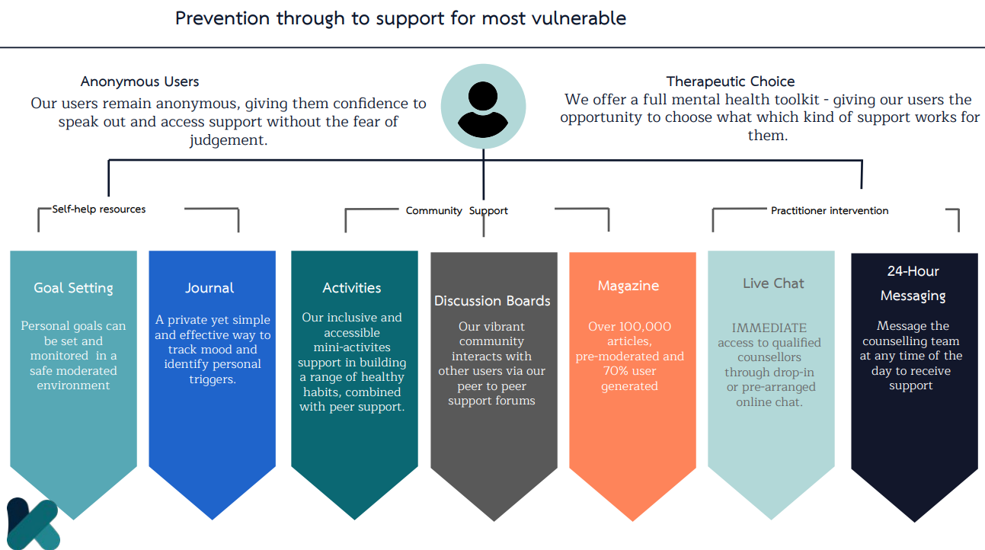
Kooth

Slide 27
Night Owls

Slide 28
Q&A
Any questions?
Review aims of the session.
Image from: Question Mark by Joel Plosz on Dribbble

Slide 29
Useful apps
The Worry Box (Managing Worries) Put your worries away in a box! While that statement seems too good to be true, this app’s idea is to help you deal with and manage your worries. You keep a personal diary in the app where you input your worries. The Worry Box then helps you decide if the worry is unimportant, important, controllable, or uncontrollable. Depending on the worry, the app will give you techniques to help manage it, like next steps or coping statements to tell yourself.
Smiling Minds (Mindfulness) The smiling mind is a mindfulness app that supports positive mental health and wellbeing. The programs education app is designed for both primary and secondary aged children.
Stop, Breathe & Think Kids (5-10 y/o emotional literacy/sleep) Only for Apple devices currently, focusses upon emotional literacy, calmness and sleep. App has an activity focus and uses emoticons and games to help young people
Mindful Gnats is an app designed to teach young people simple mindfulness and relaxation skills. It can be used to help mindfulness practice when playing the Mindful Gnats desktop game (see www.peskygnats.com for details) or as a stand alone aid to mindful practice. These skills can help to reduce stress, and improve awareness of your body, mind and world.
Headspace – mindfulness app with a kids section.

Slide 30
Useful links
Open Minds website – advice and resources for young people, parents and schools.
www.openmindscalderdale.org.uk
Mentally Healthy Schools website by Anna Freud – resources for young people and schools.
www.mentallyhealthyschools.org.uk
Kooth – safe, online, anonymous counselling for 10—25 year olds.
www.kooth.com
Time Out – simple guidance around emotional wellbeing, managing worries and looking after yourself. 10 – 19 years.
www.timeoutcalderdale.co.uk

Slide 31
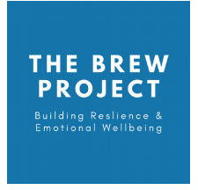
Useful links
Barnardo’s Positive Identities – specialist advice and support to those who identify or are questioning their sexual and/or gender identity. 8-25 years.
Contact details: 01422 371993 or PositiveIdentities@barnardos.org.uk
The Brew Project – 1:1 support sessions with a wellbeing officer or a 1:1 walk and talk service. 5-17 years.
Contact details: 01422 730015 or support@invictuswellbeing.com
Branching Out – specialist support and advice around drugs and alcohol. 10-21 years.
Contact details: 01422 415550
Calderdale School Nursing Team - help to manage long and short-term conditions in education settings for children and young people. 5-19 years.
Contact details: 030 3330 9974 (duty line) or online referral via online referral form

Slide 32
Useful links
Calderdale Young Carer’s Service – advice and guidance on being a young carer. 8-18 years.
Contact details: 01422 261208 or www.calderdale.gov.uk/ycs
Noah’s Ark – therapeutic services for young people and bereavement support group. Paid service.
www.noahsarkcentre.org.uk
Open Minds (CAMHS) – signposting, advice and mental health interventions for children aged 5-18 years. Also offers consultation, support, advice, training and referral guidance to parents/carers, young people and professionals.
Contact details: 01422 300 001. www.openmindscamhs.org.uk

Slide 33
Thank you for listening!
Notes:
Please complete the feedback forms!
https://forms.office.com/r/yhLC73Aszq

