Slide 1
Supporting Sleep Difficulties

Slide 2
Introductions
Claire Tooth– Education Mental Health Practitioner (EMHP)
Calderdale MHST (Mental Health Support team)
A safe space to talk confidentially, share experiences and ideas.

Slide 3
Aims
To understand the sleep cycle.
To understand what can contribute towards sleep difficulties.
To know what habits (good and bad) can impact on sleep difficulties.
To know some useful resources/strategies for supporting sleep difficulties.

Slide 4
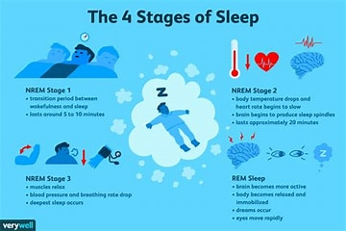
The 4 Stages of Sleep
Image from: four stages of sleep - Bing images

Slide 5
The 4 Stages of Sleep: Stages 1 & 2
Stage 1 - NREM:
Very easy to wake up from – closest stage to being awake
Can still be aware of their surroundings
This stage lasts between 1-10mins
Stage 2 - NREM:
A light sleep stage
Prepares our body for deeper sleep
Lasts up to 20mins
Sleepers in this stage are harder to wake up

Slide 6
The 4 Stages of Sleep: Stages 3 & 4
Stage 3 - NREM:
Deep sleep stage, also known as delta sleep
Very difficult to wake a person up from this stage
Phase of restorative sleep
Begins about 35-45mins after falling asleep
Stage 4 - REM:
Rapid eye movement (REM) sleep occurs after about 90mins of sleeping
First REM lasts around 10mins then gets longer in the second half of the night
Very young children spend more time in REM sleep than adults

Slide 7
Sleep quiz!

Slide 8
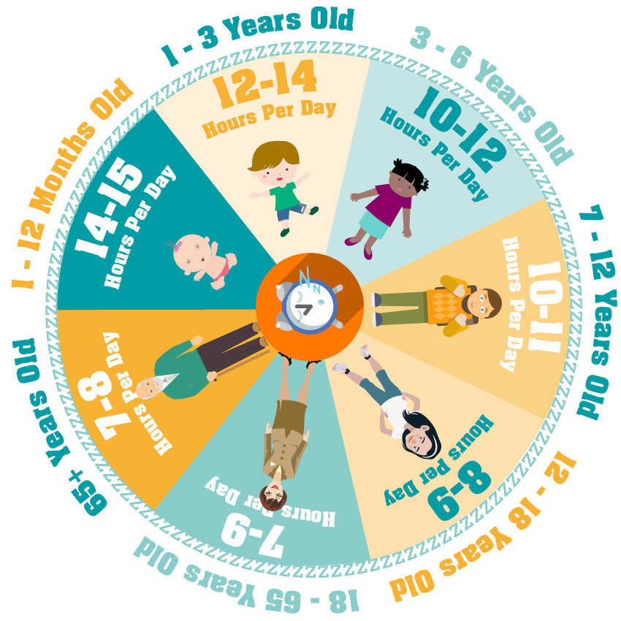
Sleep Cycle
Image from: child sleep cycle - Bing images

Slide 9
Sleep difficulties
Many of us experience trouble with sleeping at some point in our lives. Sleep difficulties usually include trouble falling asleep and getting back to sleep when you wake up in the night.
Anxiety and low mood can also affect sleep. If you feel anxious, you can find it hard to settle your mind to sleep and poor sleep can further lower mood.
Getting a good night’s sleep is key to having positive physical and mental health.

Slide 10
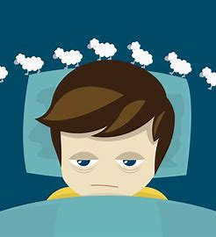
Sleep disruption
Can you think of any examples of possible causes of sleep disruption?

Slide 11
Common causes of sleep disruption
Stress or worry
Changes in sleeping patterns (e.g. staying up late playing computer games)
The environment, such as a noisy, bright, or uncomfortable bedroom
Difficult life events, such as bereavement, parents getting divorced or having a fight with a friend
Physical ill-health or pain
Unwanted side effects of medication
Emotional difficulties, e.g. anxiety or low mood
Hormonal changes

Slide 12
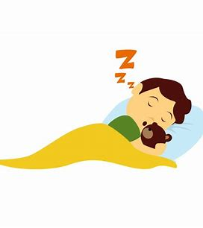
Bad habits – what keeps sleep difficulties going?
When someone has had sleep difficulties for a long time, they can develop some bad habits that can cause sleep problems to continue, or even make them worse. Below are some examples of these habits:
Not having a routine
Napping
Poor bedroom environment
Attitude to bed and bedroom
Worrying about sleep

Slide 13
Taking a closer look at sleep
There may be several factors contributing to your child’s sleep difficulties – including some you aren’t even aware of.
Are they going to bed at the same time each night and getting up at the same time each morning?
Is their bedroom a comfortable environment for sleeping in?
Do they find it more difficult to sleep at night when they have had a nap during the day?
Are they spending too much time in bed not sleeping?
Are there any worries keeping them awake?

Slide 14
How can you support healthy sleep?

Slide 15
What can you do?
Create a relaxing sleep routine
Get enough daylight
Make bed good for sleep
Avoid screens before bed
Don’t eat or drink close to bedtime
Avoid daytime napping

Slide 16
White Noise
White noise can help people sleep when they are in a noisy environment that they cannot control.
It works by blending external sounds so that your brain pays less attention to them. This is known as sound masking. The white noise is a repetitive sound that does not require your attention. Music isn’t used as this can evoke memories or thoughts which can draw your attention and keep you wakeful.
If your child is disturbed by noises at night, when they are trying to sleep, play a white noise recording of the sea for them to mask the external noises.

Slide 17
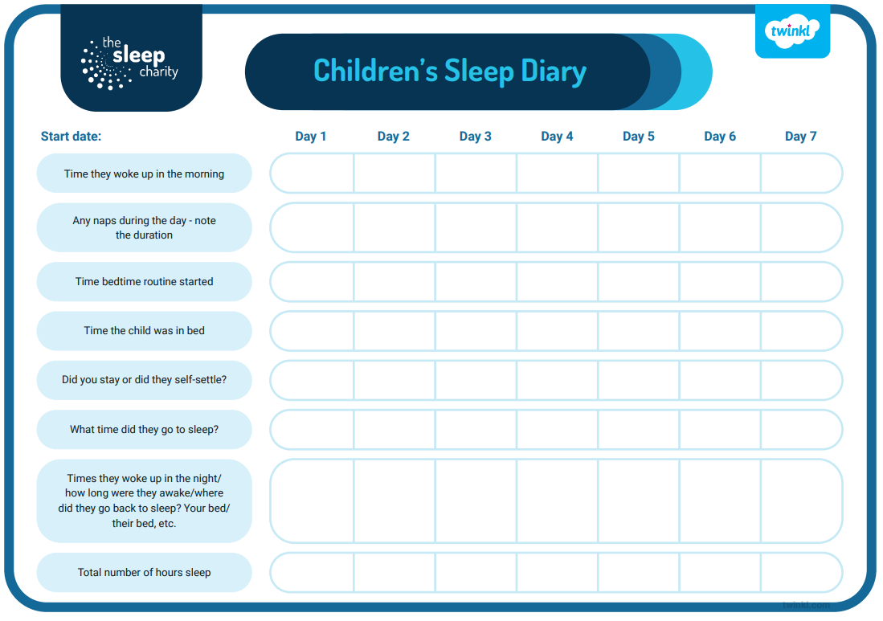
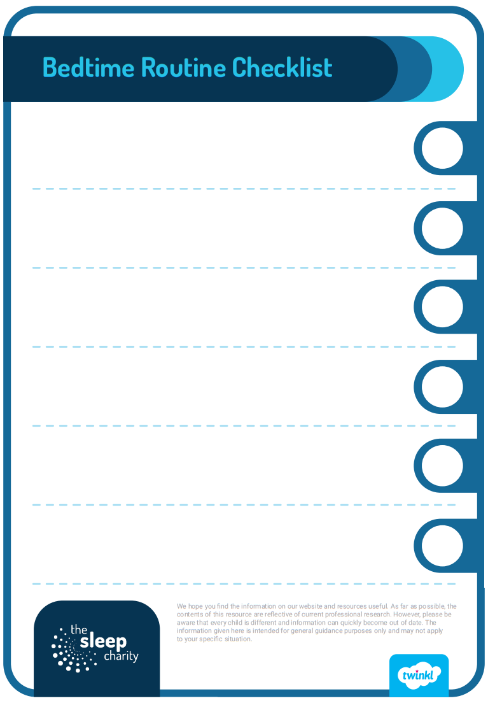
Resources
Taken from: The Sleep Charity: Editable Bedtime Routines Checklist (twinkl.co.uk); The Sleep Charity: Keeping a Sleep Diary (teacher made) (twinkl.co.uk); Sleep self-help resources - MindWell (mindwell-leeds.org.uk)

Slide 18
Useful sleep services
Sleep Tight Course –A five week online course run by the Family Support Team at a variety of times throughout the week to support parents who work or may have difficulties with childcare. 01706 399970
Sleep Helpline - Trained sleep advisors can help with concerns about children’s sleep issues, lines are open Sunday – Thursday 7pm – 9pm call: 0330 353 0541. You can find more information at: National Sleep Helpline - The Sleep Charity
Sleep Fairies (Unique Ways) – Unique Ways is a charity for families with children with disabilities. They have qualified sleep practitioners who can support you and your child. Contact them on 01422 343090 or visit the website at www.uniqueways.org.uk

Slide 19
Useful reads
NHS Self Help Sleep Guide - SLEEP-HANDBOOK-ghc-A-self-help-guide-A5-20pgs.pdf (swrecoverycollege.nhs.uk)
Sleep Charity, Sleep hygiene - Sleep Hygiene - The Sleep Charity
Sleep Line - Sleepline - Mattresses and Product Reviews | Better Sleep Starts Tonight

Slide 20
Useful links
Calderdale School Nursing Team - help to manage long and short-term conditions in
education settings for children and young people. 5-19 years: 030 3330 9974 (duty line) or online referral via online referral form
The Brew Project – 1:1 support sessions with a wellbeing officer or a 1:1 walk and talk service. 5-17 years.
Contact details: 01422 730015 or support@invictuswellbeing.com
Open Minds website – advice and resources for young people, parents and schools: www.openmindscalderdale.org.uk
Mentally Healthy Schools website by Anna Freud – resources for young people and schools.
www.mentallyhealthyschools.org.uk

Slide 21
SilverCloud: Digital Mental Health Support
Supporting an Anxious Child (4-12 years) and Supporting an Anxious Teen (13 plus) are online interventions for parental use alongside their child. The programmes are based on CBT and built in conjunction with leading clinical experts. These programmes provide psychoeducation, tools and activities in a safe confidential space to help parents support their children.
For more information please contact silvercloud@northpoint.org.uk or 01422 300 001. Referrals can be made here:
Silvercloud | Northpoint Wellbeing - Open Minds (CAMHS) (openmindscamhs.org.uk)
Notes:
Links/contacts at the end of the presentation.

Slide 22
Thank you for listening!
Notes:
Please complete the feedback forms!
https://forms.office.com/r/yhLC73Aszq

