Slide 1
Social Media & Wellbeing
Calderdale MHST
Image from: Phone telefon telefone GIF - Find on GIFER

Slide 2
Introductions
Claire Tooth and Martin Waters EMHPs (Education Mental Health Practitioner)
Calderdale MHST (Mental Health Support Team)
What is the EMHP role?
Deliver 1:1 interventions for children and young people with mild-moderate MH problems.
Supporting schools to grow and develop their “Whole School Approach” to mental health and wellbeing.
Advice and signposting to/liaising with other services.

Slide 3
Aims
To discuss and explore some of the advantages and disadvantages of social media.
To understand how social media can impact wellbeing.
To consider the impact of social media on the brain.
To consider empathy and what is being said.
To know some strategies for managing online wellbeing.

Slide 4
Social media

Slide 5
What are the advantages of social media?
Develop communication and technical skills
Building/maintaining relationships
Campaigning for social good
Self-expressions
Connections
Information
Seeking support

Slide 6
What are the disadvantages of social media?
Unrealistic expectations of reality
Lack of sleep
Desire to change appearance
Cyberbullying
FOMO – fear of missing out
Excessive use can lead to feelings of anxiety, low mood and isolation
Addiction
Image from: Sign Warning Sticker by Marcela Sabiá for iOS & Android | GIPHY

Slide 7
Cyberbullying
Many children and young people report being bullied on social media.
It is hard to get away from – it can reach a lot of people.
It can be repeated – through sharing and comments.
It can happen at any time, any day.
It can be anonymous.
It is difficult to police/punish.

Slide 8
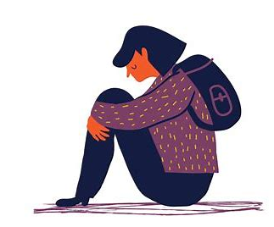
Impact on wellbeing
Feeling inadequate
Worry about comments, sharing
Not feeling good enough
Self-worth based on number of likes
Feeling isolated
FOMO – envy
Poor self-esteem

Slide 9
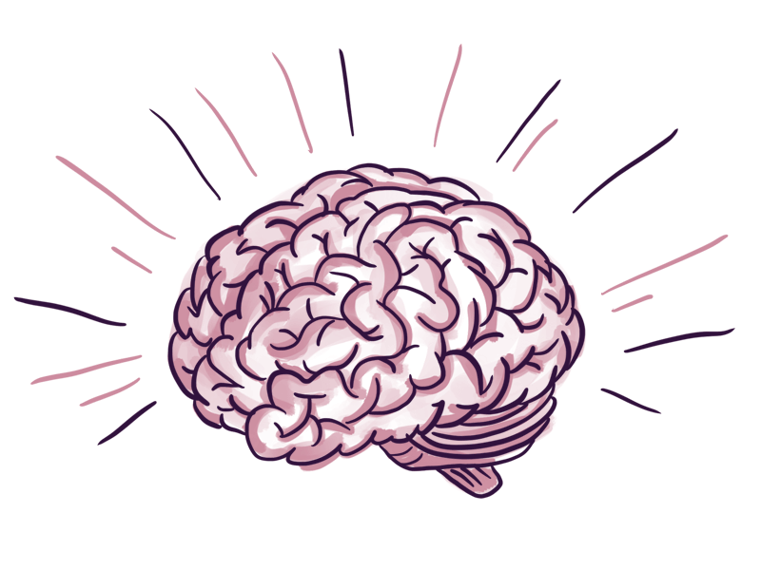
The adolescent brain!
Adolescence brings a difficult time of balance due to the conflict of physical capability and socially allowed independence.
Many behavioural/emotional changes at this time are due to brain changes as opposed to hormonal issues.
A change in neuro structure can lead to:
Increased irritability, anhedonia (no pleasure in anything) and risk-taking behaviour.
Reward processing - young people are motivated by rewards and praise, rather than the risk of a consequence.
Different decision-making capacity - more able to reflect on similar situations they have experienced before
Synaptic pruning results in a loss of pathways within the brain linking emotions and thoughts.
Image from: Brainwave by Alana Brajdic on Dribbble

Slide 10
The impact of social media on the brain
It provides the same neural circuitry as recreational drugs/gambling.
Likes and shares can create a chemical reaction in the brain similar to using cocaine
Reward centres are heightened when talking about ourselves – in the real world we only do this 30-40% of the time, compared to 80% on social media
Worse if it’s used as a coping mechanism
It can lead to a behavioural addiction
It may look like any other addiction

Slide 11
Social media addiction
To determine if someone is at risk of developing an addiction to social media, ask these 6 questions:
Do they spend a lot of time thinking about social media or planning to use social media?
Do they feel urges to use social media more and more?
Do they use social media to forget about personal problems?
Do they often try and reduce the use of social media without success?
Do they become restless or troubled if unable to use social media?
Do they use social media so much that it has a negative impact on their job or studies?
A ‘yes’ to three or more of these questions may indicate the presence of a social media addiction.
(Addiction Centre)

Slide 12
How can social media be used responsibly and safely?
What we need to tell young people:
Delete and unfollow people
Set yourself boundaries/time limits
Be kind
Follow those who help you – is it a healthy or unhealthy account?
Create positive content
Reality is better
Stop comparing
Report it!
Image from: Be Kind Love Sticker for iOS & Android | GIPHY

Slide 13
Empathy
“Empathy is the ability to emotionally understand what other people feel, see things from their point of view, and imagine yourself in their place. Essentially, it is putting yourself in someone else's position and feeling what they must be feeling. When you see another person suffering, you might be able to instantly envision yourself in the other person's place and feel sympathy for what they are going through.”

Slide 14
THINK
True – are you spreading gossip or fake news?
Helpful – does sharing help?
Inspiring – does it inspire someone?
Necessary – does it need to be said?
Kind – is it kind or hurtful?

Slide 15
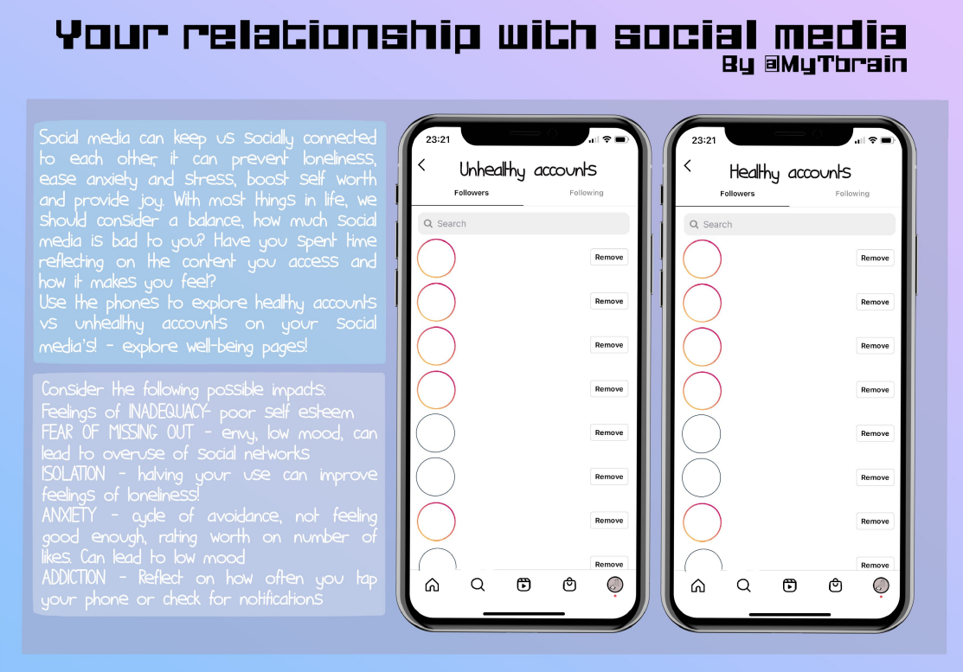
Healthy or unhealthy?
Go through the accounts your child follows and discuss with them if they are healthy or unhealthy accounts?
Delete any accounts that you identify as unhealthy!

Slide 16
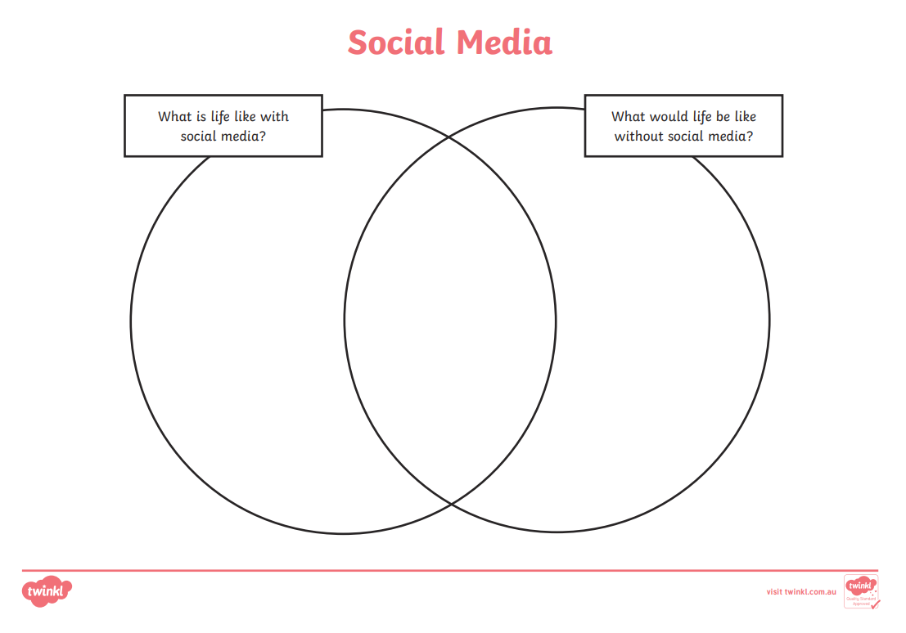
Advantages/ disadvantages
Discuss with your child what the advantages and disadvantages of using social media are.
What is life like with social media? What would it be like without it/using it less?
Taken from: Social Media Resource Pack (teacher made) (twinkl.co.uk)

Slide 17
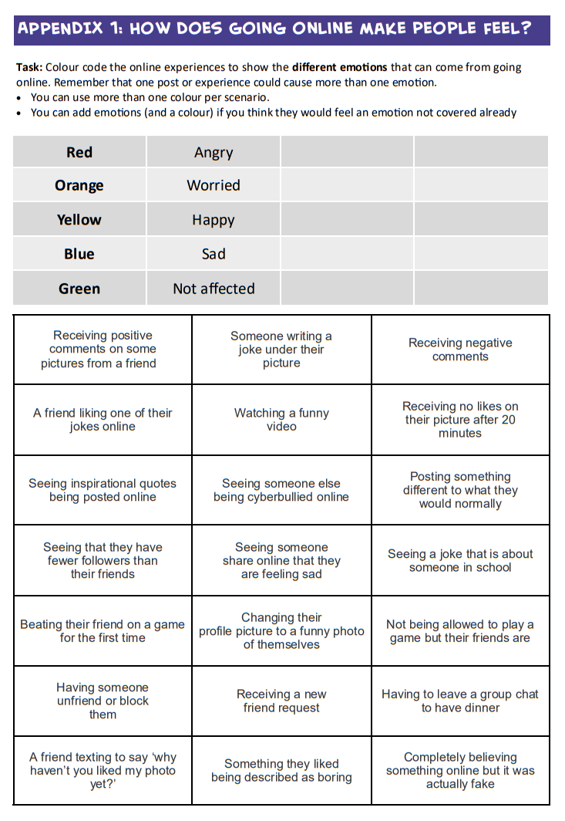
How does it make them feel?
Explore how social media makes your child feel.
Talk to them about this and try to identify ways that you can help manage these feelings and feel better again.
Taken from: Lesson-plan.pdf

Slide 18
What to do if more support is needed?
Look at the Open Minds website – this has lots of great resources and tips for young people.
The Open Minds Partnership includes different services in Calderdale which offer different kinds of support:
Time Out – guidance about emotional wellbeing, managing worries and looking after yourself. 10-19 years.
Kooth – online, anonymous counselling. 10-25 years.
Barnardo’s Positive Identities – advice and support for those who identify or are questioning their gender and/or sexual identity. 8-25 years.
Calderdale Young Carer’s Service – advice and guidance on being a young carer. 8-18 years.
Branching Out – specialist support and advice around drugs and alcohol. 10-21 years.
The Brew Project – 1:1 support sessions or 1:1 ‘walk and talk’ service. 5-17 years.
Calderdale School Nursing Team – help to manage long and short-term conditions in education settings for children and young people. 5-19 years.
Open Minds (CAMHS) – advice and signposting, 1:1 specialist mental health support. 5.18 years.

Slide 19
What to do if more support is needed?
Silvercloud – Open Minds (CAMHS) is now able to offer access to free on-line support for young people, parents and carers.
This support is free, accessible and involves minimal waits. A ‘Supporter’ from Open Minds (CAMHS) will provide on-line encouragement, guidance and advice and help monitor risk and effectiveness.
In order to benefit from Silvercloud support, young people (aged 14+) or their parents/carers will need access to a device (smartphone, tablet or laptop) and be IT literate. This support is not suitable for young people where there are significant risk concerns.
Supporting an Anxious Child and Supporting an Anxious Teen are online interventions based on CBT and built in conjunction with leading clinical experts. The programmes provide psychoeducation, tools and activities in a safe confidential space to help parents support their children or teens.
For more information please contact silvercloud@northpoint.org.uk or 01422 300 001. Referrals can be made here: Silvercloud | Northpoint Wellbeing - Open Minds (CAMHS) (openmindscamhs.org.uk)

Slide 20
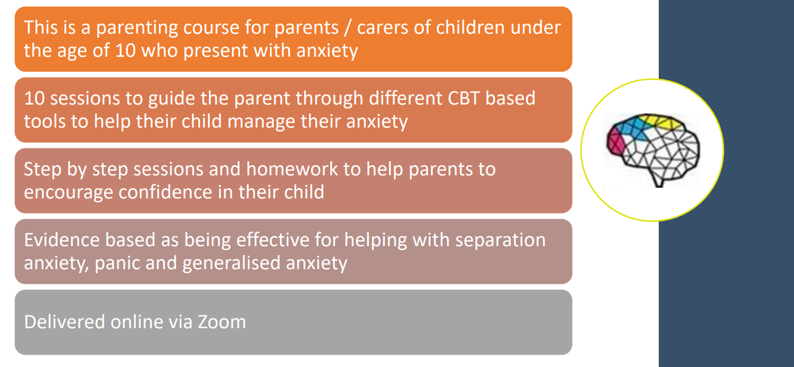
Timid to Tiger

Slide 21
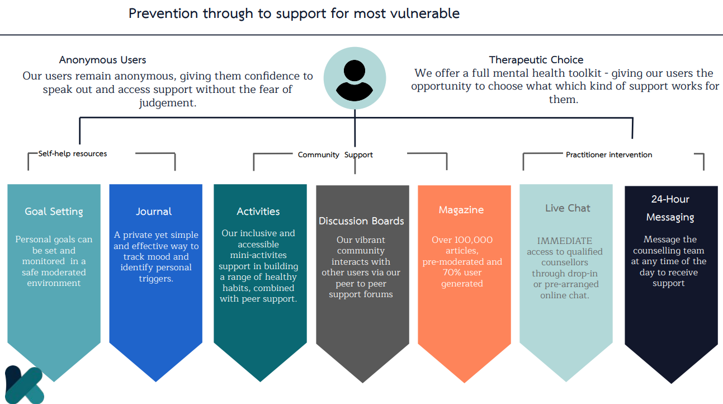
Kooth

Slide 22
Q&A
Any questions?
Review aims of the session.
Image from: Question Mark by Joel Plosz on Dribbble

Slide 23
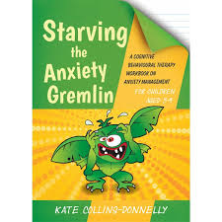
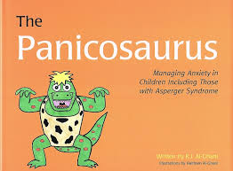
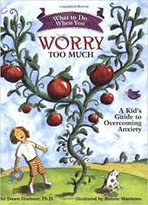
Useful books
‘The Huge Bag of Worries’ by Virginia Ironside
‘Starving the Anxiety Gremlin’ by Kate Colling-Donnelly
‘Panicosaurus’ by K.I Al-Ghani
‘Think Good, Feel Good’ by Paul Stallard
‘What To Do when You Worry Too Much’ by Dawn Huebner

Slide 24
Useful apps
The Worry Box (Managing Worries) Put your worries away in a box! While that statement seems too good to be true, this app’s idea is to help you deal with and manage your worries. You keep a personal diary in the app where you input your worries. The Worry Box then helps you decide if the worry is unimportant, important, controllable, or uncontrollable. Depending on the worry, the app will give you techniques to help manage it, like next steps or coping statements to tell yourself.
Smiling Minds (Mindfulness) The smiling mind is a mindfulness app that supports positive mental health and wellbeing. The programs education app is designed for both primary and secondary aged children.
Stop, Breathe & Think Kids (5-10 y/o emotional literacy/sleep) Only for Apple devices currently, focusses upon emotional literacy, calmness and sleep. App has an activity focus and uses emoticons and games to help young people
Mindful Gnats is an app designed to teach young people simple mindfulness and relaxation skills. It can be used to help mindfulness practice when playing the Mindful Gnats desktop game (see www.peskygnats.com for details) or as a stand alone aid to mindful practice. These skills can help to reduce stress, and improve awareness of your body, mind and world.
Headspace – mindfulness app with a kids section.

Slide 25
Useful links
Cyberbullying: https://www.bullying.co.uk/cyberbullying/what-to-do-if-you-re-being-bullied-on-a-social-network/
Internet Matters: https://www.internetmatters.org/resources/social-media-advice-hub/
Mentally Healthy Schools website by Anna Freud – resources for young people and schools.
www.mentallyhealthyschools.org.uk
Kooth – safe, online, anonymous counselling for 10—25 year olds. www.kooth.com
Time Out – simple guidance around emotional wellbeing, managing worries and looking after yourself. 10 – 19 years.
www.timeoutcalderdale.co.uk

Slide 26
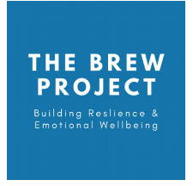
Useful links
Barnardo’s Positive Identities – specialist advice and support to those who identify or are questioning their sexual and/or gender identity. 8-25 years.
Contact details: 01422 371993 or PositiveIdentities@barnardos.org.uk
The Brew Project – 1:1 support sessions with a wellbeing officer or a 1:1 walk and talk service. 5-17 years.
Contact details: 01422 730015 or support@invictuswellbeing.com
Branching Out – specialist support and advice around drugs and alcohol. 10-21 years.
Contact details: 01422 415550
Calderdale School Nursing Team - help to manage long and short-term conditions in education settings for children and young people. 5-19 years.
Contact details: 030 3330 9974 (duty line) or online referral via online referral form

Slide 27
Useful links
Calderdale Young Carer’s Service – advice and guidance on being a young carer. 8-18 years.
Contact details: 01422 261208 or www.calderdale.gov.uk/ycs
Noah’s Ark – therapeutic services for young people and bereavement support group. Paid service.
www.noahsarkcentre.org.uk
Open Minds (CAMHS) – signposting, advice and mental health interventions for children aged 5-18 years. Also offers consultation, support, advice, training and referral guidance to parents/carers, young people and professionals.
Contact details: 01422 300 001. www.openmindscamhs.org.uk

Slide 28
Thank you for listening!
Notes:
Please complete the feedback forms!
https://forms.office.com/Pages/ResponsePage.aspx?id=sbohuJ2qTUy7JT9q1MAUZYVhUKlCCuFEgWw03kXeVeBUMzlCR0s0QUFXVUJMRFZCOUFNTTQ4TjNWVy4u

